Slide 1
CAR RIDE-SHARE POTENTIAL IN MID-SIZE U.S. CITIES FROM GEOGRAPHIC SPREAD
Jens Koeplinger, 20 March 2019
This presentation is part of satisfying the IBM Data Science Specializa- tion on Coursera, Course 9 ”Applied Data Science Capstone”

Slide 2
Objective
Fictitious analysis requested by a car ride-share company startup, looking for the best suited places to roll out their service.
Customers will be able to sign up for shared car rides across town.
The cities need to be geographically spread out, with venues arranged in a non-compact manner as opposed to centered around a single core, and
they need to have a significant number of venues of types that indicate a population open to trying out new transportation arrangements.

Slide 3
Data and success criterion
Cities with 300,000 and 400,000 inhabitants according to the 2017 census estimate.
Indicator venues include alternative eating, lifestyle, and work types. This may include coworking spaces, yoga studios, delicatessen, tea rooms, vegan and other nonstandard restaurants.
A successful study clusters cities by geographic spread of their venues, and then ranks them within each cluster by relative occurrence of indicator venues as com- pared to total venues.

Slide 4
City: population 300,000 - 400,000 (2017)
There are 19 cities (per 2017 U.S. Census estimate), across the US:
California: Bakersfield, Anaheim, Santa Ana, Riverside, Stockton.
Ohio: Cleveland, Cincinnati.
Texas: Arlington, Corpus Christi.
All other states: New Orleans, LA, Wichita, KA, Tampa, FL, Aurora, CO, Honolulu, HI, Lexington, KY, St. Louis, MO, Saint Paul, MN, Henderson, NV, and Pittsburgh, PA.

Slide 5
Indicator venues
The ficticious company provided a list of substrings to search for in venue type.
If the substring is found, it is considered an “indicator venue” for a city population more open to trying out the company’s new service.
The provided substring list is:
share, sharing, incubat, innovat, coworking, alternative, yoga, salad, bike, 􏰂tness, running, jogging, cycling, cycle, athletics, gluten, health, recreation, tennis, vegetarian, vegan, disc golf, pilates
This is highly subjective.

Slide 6
Foursquare foraging algorithm
Start at a reference coordinate,
get number of venues in certain distance,
search a hex grid for nearby venues,
continue at coordinate with most venues.
Iterate until maximum number of coordinates checked.
While at it, collect venue type and count indicator venues.

Slide 7
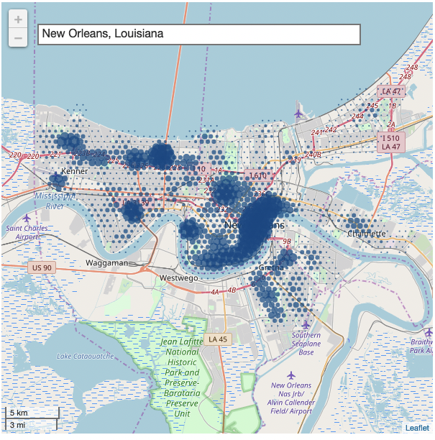
Example: New Orleans, LA
Most venues are at the city’s
most popular area

Slide 8
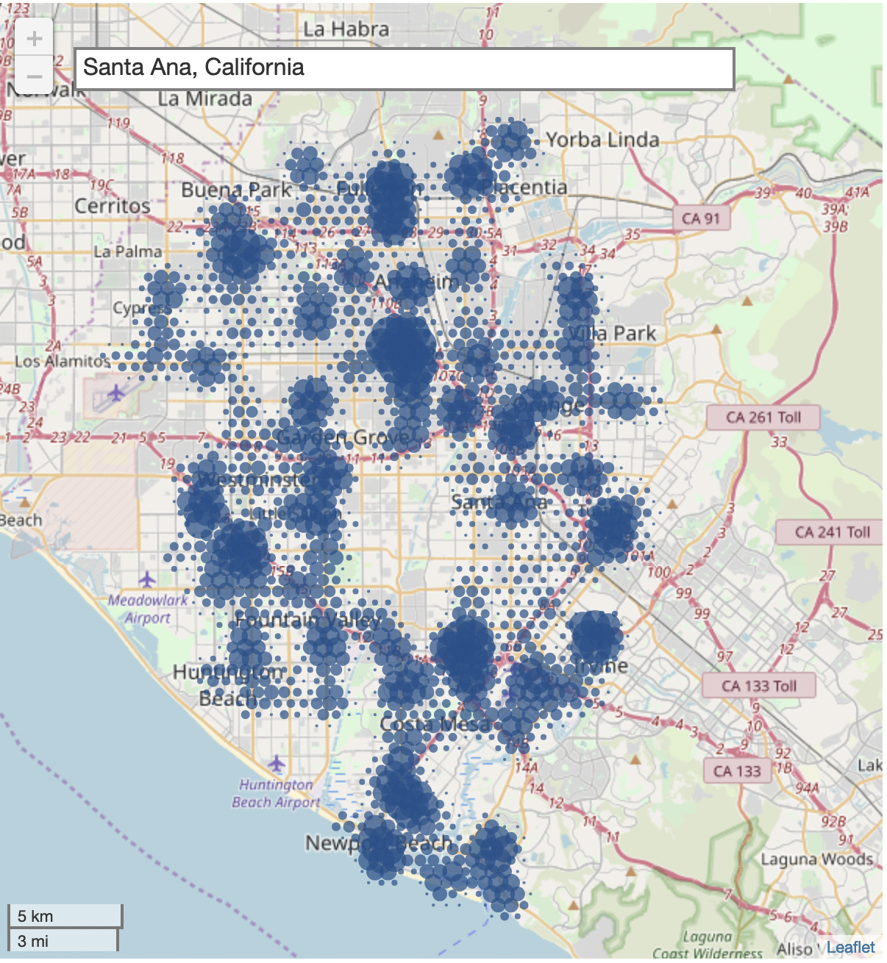
Example: Santa Ana and Anaheim, CA
Cities run into one another

Slide 9
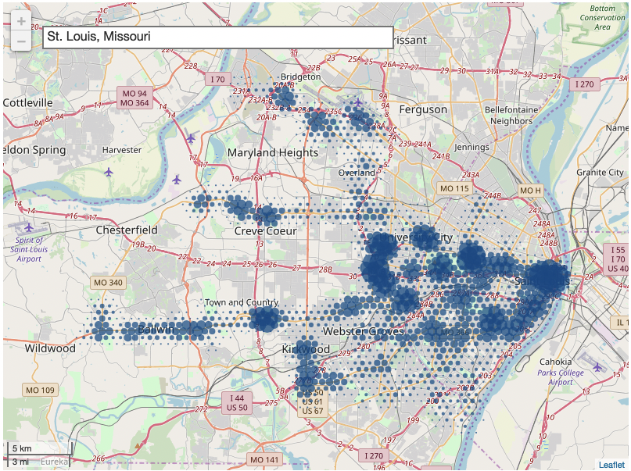
Example: St. Louis, MO
Center with veins

Slide 10
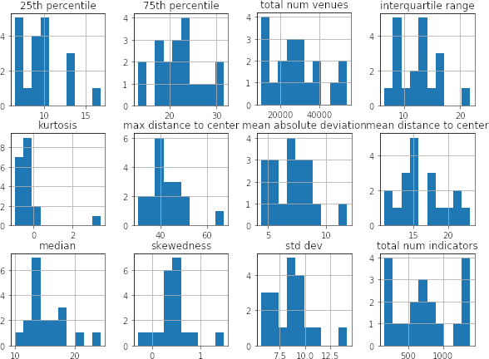
Aggregate geographic spread
Flatten dataset using descriptive analytics for each city, of venue distance to center:

Slide 11
Feature engineering
Remove highly correlated data points,
build features by standardizing and bounding the data points:
Divide by standard deviation,
center, and
apply arctan to reduce the effect of outliers.

Slide 12
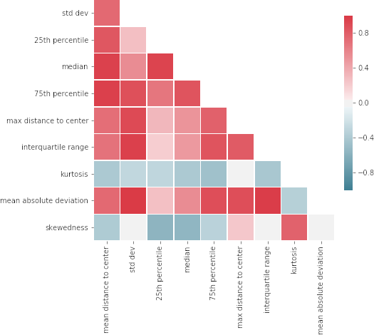
Correlations
Data points to exclude:
Mean absolute deviation,
mean distance to center,
median,
standard deviation.

Slide 13
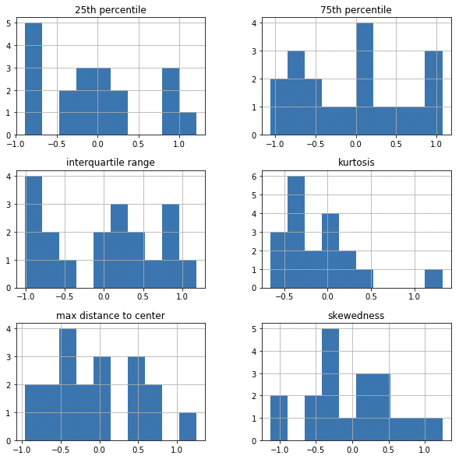
Final features
Feature value distribution after
selection, standardization
and bounding:

Slide 14
K-means clustering
Saint Paul, MN is the “most indicative city” (highest relative percentage of indicator values).
Apply k-means on the features:
Appears stable for Saint Paul, consistently putting it together with the same four or five other cities,
The cluster contains other cities with high relative percentage of indicators.
Methodology overall appears stable in the result from clustering, and there is a single cluster that contains the cities with highest number of indicator venues:

Slide 15
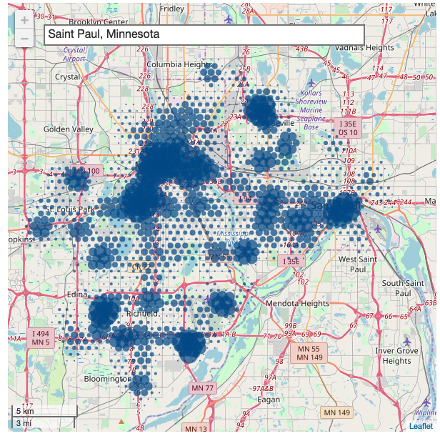
Result #1 (of 3): Saint Paul, MN

Slide 16
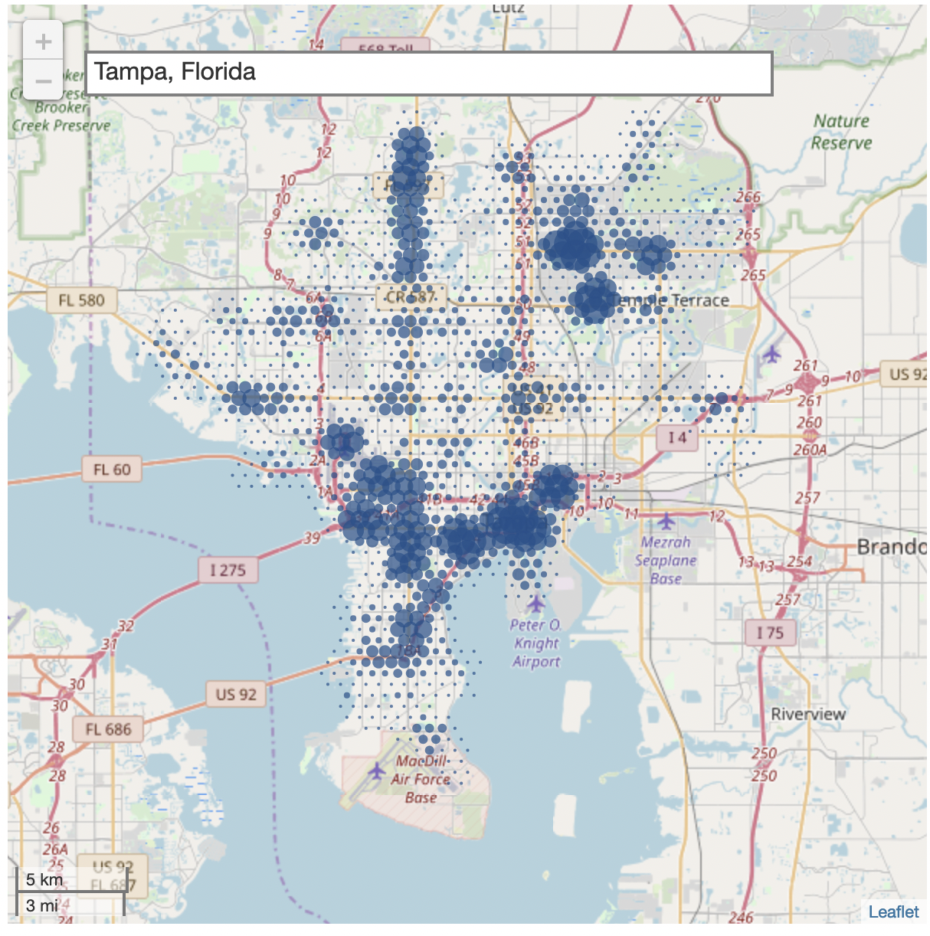
Result #2 (of 3): Tampa, FL

Slide 17
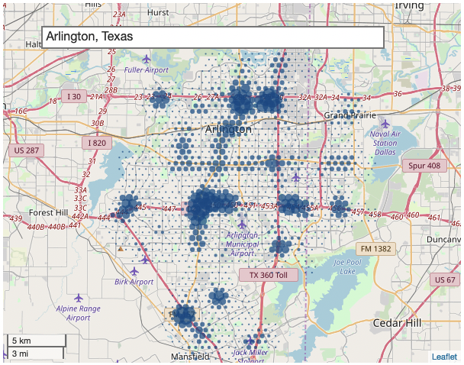
Result #3 (of 3): Arlington, TX

Slide 18
Cross check: Geographic spread
By visually inspecting the venue spread for the top 3 cities, we confirm the desired geographic spread of venues (as opposed to centralization).
The methodology is consistent with the fictitious company’s requirements.

Slide 19
Bias
Various factors bias the result:
Indicator venue selection is highly subjective.
Foursquare venue search by radius double-counts venues due to overlap.
Foursquare venue collection depends on contributing users.
Algorithm avoids natural barriers (e.g. broad rivers).
Algorithm runs into neighboring cities (thereby violating the study premise of population size) by following areas with a higher density of venues.
Recommendation: Perform another study with modified methodology, and compare the results.

Slide 20
References
Report (including source references): https://github.com/koeplinger/sandbox-ibm-ds/blob/master/carRideShareAnalysisReport.pdf
Investigation notebooks: https://github.com/koeplinger/sandbox-ibm-ds/blob/master/ibmDsSpecCourse9capstone.ipynb

